Slide 1
How to Prepare a Talk
Shaull Almagor
February 14, 2022
LMW@CSL

Slide 2
How I Prepare a Talk
Shaull Almagor
February 14, 2022
LMW@CSL

Slide 3
How I Prepare a Talk about Determinization of One Counter Nets
Shaull Almagor
February 14, 2022
LMW@CSL

Slide 4
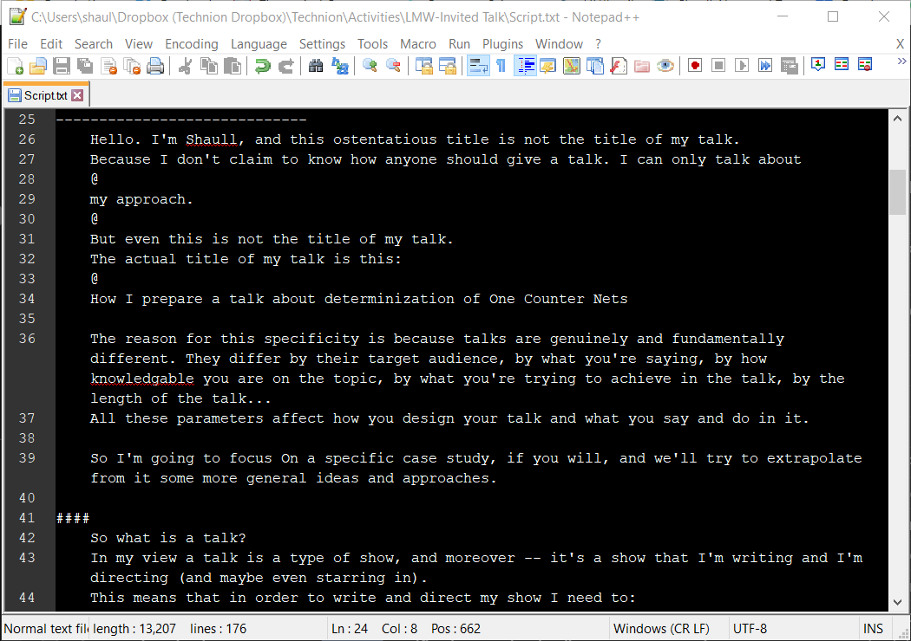
It’s a Show!
A talk is a show, I’m the director and writer.
Think about the context and audience of the talk.
Think about what you want to achieve in the talk, and how.
Plan the presentation. Practice it. Rehearse it.
What kind of show will you put on?
Comedy
Standup
Drama
Thriller
…

Slide 5
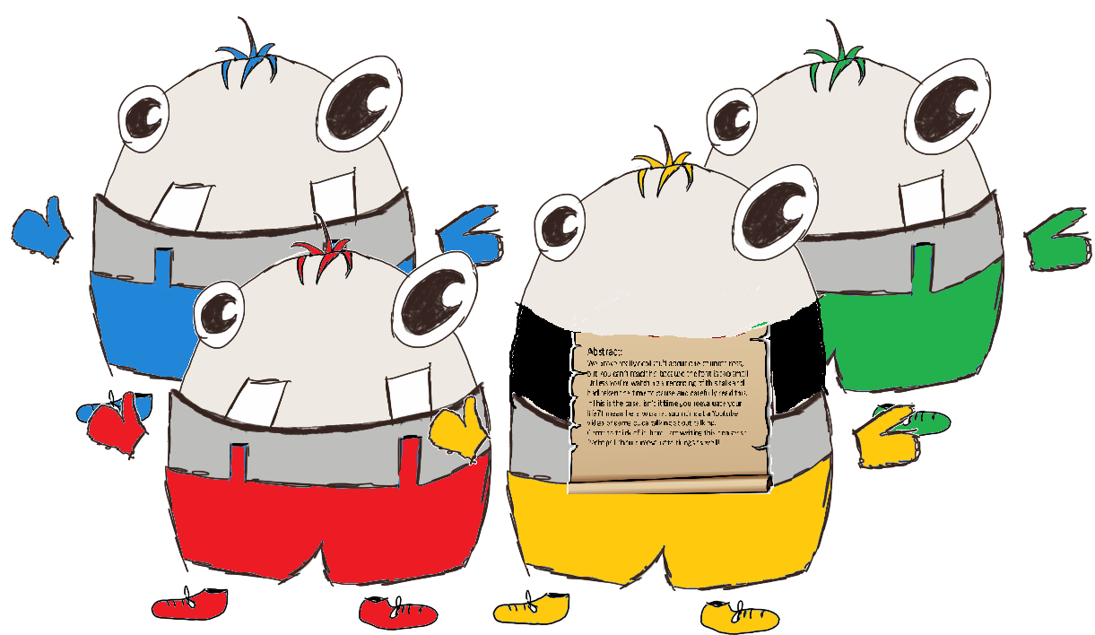
What Do I Want To Achieve?
I want the audience to think:
Hmm. That’s quite nice.
I hadn’t thought of that.
I should remember this technique/this result/this person.
Something that would linger.

Slide 6
What Contents Should I Choose?
Motivations
Definitions
Theorems
Techniques
Experimental results

Slide 7
What Contents to Choose (OCN)
OCNs – not everyone are familiar with them.
The main contributions:
Notions of determinization – Definitions / Motivations
Preliminary observations about them – Theorems
Undecidability results – Theorems
Decidability of a fragment – Techniques

Slide 8
How Will I Achieve My Intents?
This is (arguably) the most important part.
Good presentation can compensate for poorly-chosen contents.
But it shouldn’t. It should support well-planned contents.

Slide 9
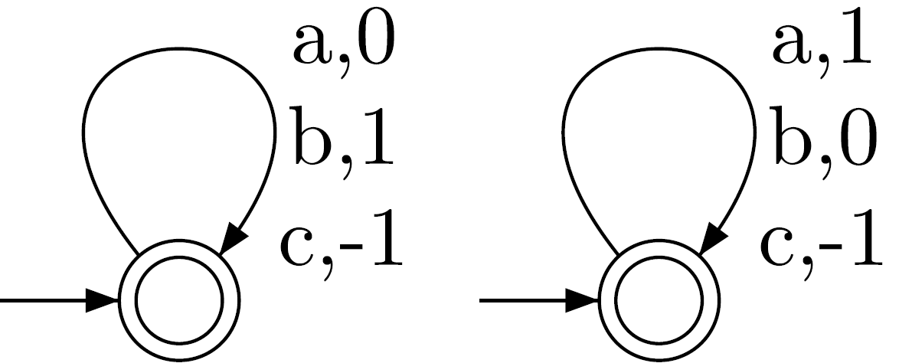
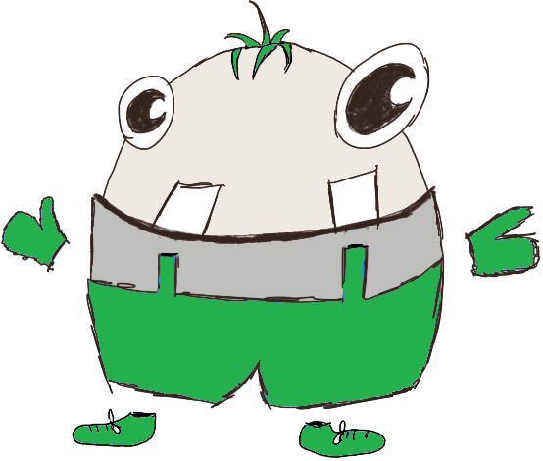
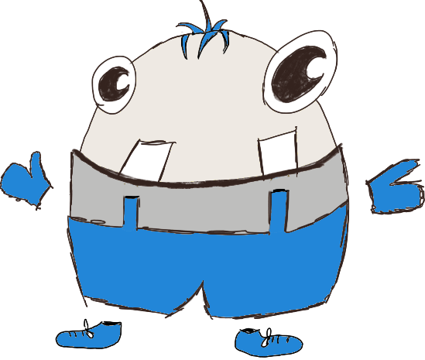
Setting the Stage (OCN)
$$>0$$
$$=0$$
0
+1
+1
0
-1
-1
Froot Fruit
-1

Slide 10
Setting the Stage
Humor
“Enjoyment” links you to the audience.
Routine break.
Preps the brain for learning.
Anthropomorphism
From to
Story
I Think therefore
I determinize OCNs
Q.E.D

Slide 11
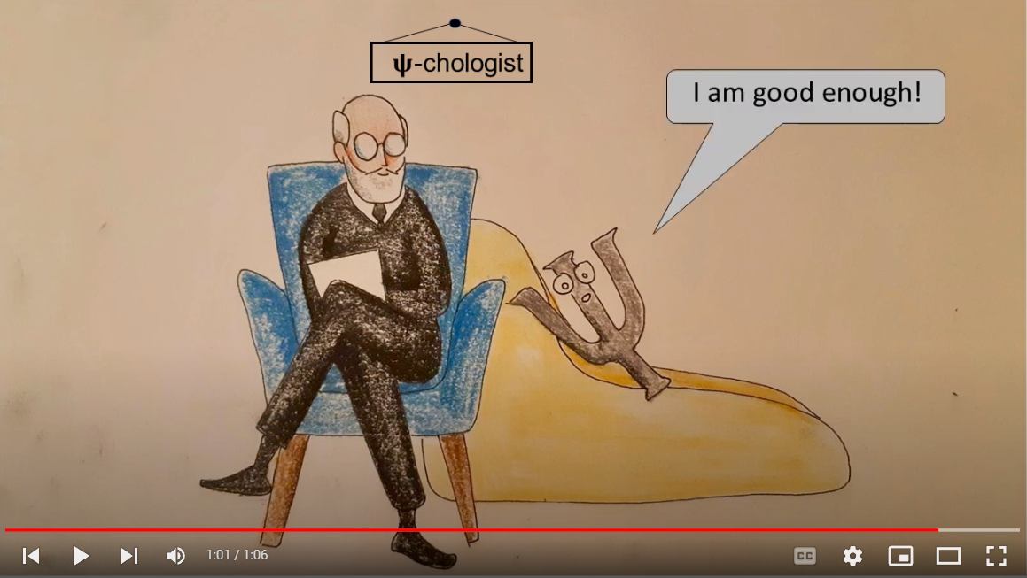
Go Crazy!

Slide 12
Definitions of Determinizability (OCN)
Consider a nondeterministic OCN $N$
4 Notions of Determinizability:
$∃$-det: $∃c ∃D L\left(N,c\right)=L(D,c)$
$0$-det: $∃D L\left(N,0\right)=L\left(D,0\right)$
$∀$-det: $∀c ∃D L\left(N,c\right)=L\left(D,c\right)$
U-det: $∃D ∀c L\left(N,c\right)=L(D,c)$
If we start the day with $c$ coins
If we start the day with $0$coins
Yes, I’ll figure out how depending on $c$
Sure

Slide 13
Separating the Definitions
$∃$-det: $∃c ∃D L\left(N,c\right)=L(D,c)$
+1
+1
0
0
0
0
-5
0
0
-1
-1
0
$0$-det: $∃D L\left(N,0\right)=L\left(D,0\right)$
+1
+1
-1
0
0
-1
-1
-1
$∀$-det: $∀c ∃D L\left(N,c\right)=L\left(D,c\right)$
$$1,a$$
$$−1,b$$
$$0,\#$$
$$−1,\#$$
$$0,a$$
$$0,b$$
U-det: $∃D ∀c L\left(N,c\right)=L(D,c)$

Slide 14
Presenting Easy Results
Easy results help the audience grasp the model
Easy = I said it’s easy.
And I have supporting evidence.
The audience should “feel” it’s easy.
Don’t condescend!
Easy results build credibility (for difficult results).

Slide 15
Results (OCN)
Theorem:
Whether an OCN is $∃$-det/0-det/$∀$-det is undecidable.
Theorem:
Whether an OCN is U-det is Ackermann-hard. Decidability is open.
Over Singleton Alphabet:
Lots of movement
Theorem:
Whether an OCN is $∃$-det/0-det/$∀$-det is trivial (always “yes”).
Theorem:
Deciding whether an OCN is U-det is decidable.

Slide 16
Showing Results
Pros
Cons
Big Picture
Anchor
…
Spoils the ending
…

Slide 17
$∃$-det is Undecidable (OCN)
Theorem:
Whether an OCN is $∃$-det is undecidable.
Proof:

Slide 18
How to Wrap Up (I’m not wrapping up yet)
4 Definitions of OCN determinizability
Most definitions yield undecidability.
One open case.
For singleton alphabets :
Most definitions always hold.
One decidable case.
Future research:
Solve the open problem
Tighten the complexity
Reminders to invite questions
Acknowledge gaps
Thank you!
“Thanks” on this slide.
Never go over time!
Resolve the story

Slide 19
Wrap Up (for real)
Incite questions
Use colors
Be funny
Plan the talk
Say what is easy
Movement on screen
Know the audience
Use memes
Say what is hard
Stay on time
No proofs
Vary your tone
Think.
Anthropomorphism
Don’t give away the ending
Distill ideas
Don’t be boring
Be clear
Break the 4th wall
It’s a show
Go crazy
Surprise
Tell a story
Choose contents carefully
Don’t condescend
Practical researchers are inferior

